Slide 1
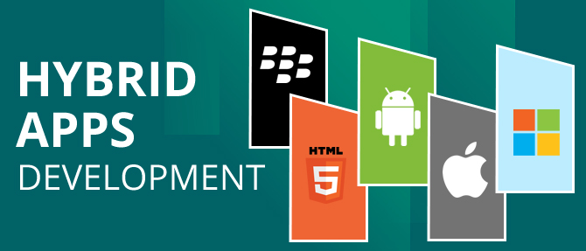

Slide 2
Agenda
Introduction
Why use it Hybrid Mobile Application?
Advantage of Hybrid Mobile Application
Disadvantage of Hybrid Mobile Application
Native Vs Hybrid Vs Web Comparison
Apache Cordova Introduction
Create Your First Application
Insert Cordova Plugin in Application
Import Application in Android Studio (Android)

Slide 3
Introduction
Hybrid applications are web applications (or web pages) in the native browser, such as UI WebView in iOS and WebView in Android (not Safari or Chrome). Hybrid apps are developed using HTML, CSS and JavaScript, and then wrapped in a native application using platforms like Cordova. This allows you to use any web-native framework you want, and there are plenty of these.
The application development is faster, simpler, more rapid and the application is easier to maintain. You can change platforms anytime you need, Cordova lets you build your application for more than one platform just by one adding line of code. As for the phone hardware such as the camera or Bluetooth, Cordova has a large repository of plugins you may use.
Hybrid apps are a way to expose content from existing Web sites in app format. They’re a great way to take your Web content and package it up for publishing in an app store.

Slide 4
Why use it Hybrid Mobile App?
Hybrid apps are also popular because they allow cross platform development.
Hybrid apps reduce development costs: that is, the same HTML code components can be reused on different mobile operating systems. Tools such as PhoneGap and Sencha Touch allow people to design and code across platforms.
Hybrid apps can access the native device components such as sensors, camera, device orientation, network, etc... Using Apache Cordova framework.
You can publish hybrid apps in any of the major app stores: Microsoft Windows Store, Google Play, Apple App Store, Amazon App Store and even BlackBerry World.

Slide 5
Advantage of Hybrid Mobile App
Design of Interface:- Hybrid app development uses HTML5 and CSS3 that have far superior capabilities when designing interfaces with many form factors and highly dynamic content.
Reduce Development Timeline:- Hybrid app are easier and faster to develop and deploy. However, if there are a lot of native and complicated features that are beyond the capability of the hybrid app Framework and Environment, then it will be more time consuming to build for hybrid apps..
Reduce Development Cost:- Hybrid app development, you can build it once and submit it to all of the platforms (iPhone, Android, Windows Phone) using PhoneGap technology. So, you would be saving money by not having to build the app using native programming language of each platform.
Code Reusability/Portability:- Hybrid app is more maintainable as long as the developer chooses a right framework such as KendoUI, jQuery mobile, Ionic, etc. This is because it is easier to maintain the Web app technology (HTML, CSS and JavaScript) than a native app technology.

Slide 6
Advantage of Hybrid Mobile App
Platform Independent:- One of the main advantage of hybrid app development is that the developer can build it once and then using a technology such as Adobe PhoneGap, submit the app to all platforms (iPhone, Android, Windows Phone and Blackberry).
Device Features:- Although web apps can take advantage of some features, native apps (and the native components of the hybrid apps) have access to the full paraphernalia of device-specific features, including GPS, camera, gestures, and notifications.
Maintenance. Maintaining a native app can be complicated not only for users, but also for developers (especially if they have to deal with multiple versions of the same information on different platforms): Changes have to be packaged in a new version and placed in the app store. On the other hand, maintaining a web app or a hybrid app is as simple as maintaining a web page, and it can be done as often or as frequently as needed.

Slide 7
Advantage of Hybrid Mobile App
Item | Native has Advantage | Hybrid has Advantage
Cost
Platform Independent
Quicker Development
User Experience
No Limitations
Support
Tools and Debugging

Slide 8
Disadvantages of Hybrid Mobile App
Design of Interface:- However, there are some drawbacks and interface design issues that may come up when using hybrid app development.
Sometimes it is tedious and is time consuming to implement certain standard native user experience designs and complicated interfaces using hybrid app development technology.
User Experience & Performance:- Native apps provide better performance, responsive and fluid experience and a user can navigate and interact with the app without noticing any loading delays.
Hybrid apps tend to have some user interaction delays, and users can notice that the app is not as responsive sometimes.
Security:- Depending on the security requirements of the project, native apps may provide better security environment; however, most of the security issues are created based on the developers lack of experience is security and server-side security issues.
So, if the app requires many security features, you may need to make sure that all of the security features can be implemented in a hybrid app environment.

Slide 9
Disadvantages of Hybrid Mobile App
Limitations:- When building hybrid apps, the developer relies on the mobile app development framework and tools and it's capabilities and provided features to build the app. So, if the tools and framework used is not up-to-date to provide a certain new features, the developer will be at the disadvantage and cannot implement features that are not provided by the hybrid app development Framework and Tools.
Tools & Debugging:- Native development provides better development environment and tooling to test and debug the work, so it is much easier and less time consuming to find and fix bugs using native development Tools.
There are not reliable hybrid app development tools that can help with debugging and fixing issues, so, sometimes the developer may spend a few hours to fix a problem in hybrid app environment

Slide 10
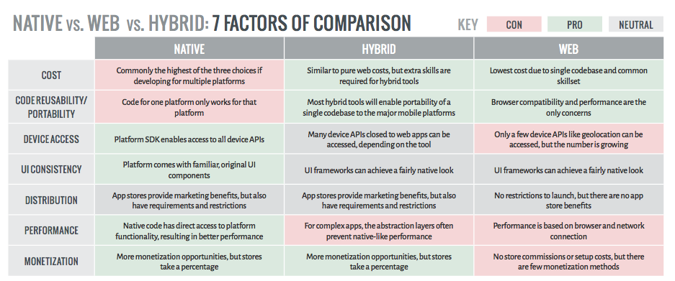
Native VS Hybrid VS Web

Slide 11
Native VS Hybrid VS Web
 | Native | Hybrid | Web
App Features
Graphics | Native APIs | HTML, Canvas, SVG | HTML, Canvas, SVG
Performance | Fast | Slow | Slow
Native look and feel | Native | Emulated | Emulated
Distribution | App store | App store | Web
Deice Access
Camera | Yes | Yes | No
Notifications | Yes | Yes | No
Contacts, Calendar | Yes | Yes | No
Offline Storage | Secure File Storage | Secure file System, shared SQL | Shared SQL
Gestures
Swipe | Yes | Yes | Yes
Pinch, Spread | Yes | Yes | No
Development Skills | Objective C, Java | HTML5, CSS, JS | HTML5, CSS, JS

Slide 12
Hybrid App Builder
PhoneGap (Apache Cordova)
Sencha Touch
Titanium
Telerik Platform
Ionic

Slide 13
Hybrid Mobile App Framework
jQuery Mobile
Ionic
Mobile Angular UI
Intel XDK
Kendo UI
Monaco
Onsen UI
Framework 7

